Slide 1

University Institute of Liberal Arts and Humanities
Course Name – Communication Skills
Course Code – 23PCH-105
Communication Skills- Types, and Models
DISCOVER . LEARN . EMPOWER

Slide 2
COURSE OBJECTIVES
The Course aims to:
1 | Augment students overall communication and interpersonal skills by making them realize the importance of good oral and written English Language in professional life.
2 | Enrich their reading capability with special emphasis on expanding vocabulary and grammatical formations.
3 | Build exceptional speaking, reading and writing skills by correcting grammatical errors and pronunciation through practice.
4 | Enhances soft skills by fostering self awareness, confidence and a positive attitude in students’ ability to communicate effectively in English.

Slide 3
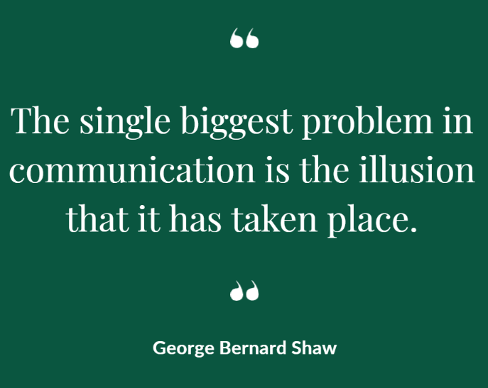
Course Outcomes
On completion, the students are expected to:
CO Number | Title | Level
CO1 | Apply appropriate Listening, Speaking, Reading and Writing Skills (LSRW Skills) with correct non-verbal cues to attain expertise in soft skills. | Apply
CO2 | Apply correct contextual and comprehensible written text in the form of paragraph writing, short compositions business correspondence, using logical support and argument in a wide range of communication situations. | Apply
CO3 | Demonstrate linguistic competence while speaking and during presentations through accuracy in grammatical usage, vocabulary, pronunciation and intonation. | Apply
CO4 | Evaluate information as critical readers, speakers and writers applying ethics in communication and being sensitive in cross cultural communication. | Evaluate
CO5 | Create original, digital content for websites, blogs, vlogs and personal social media profiles etc. | Create

Slide 4
Types of Communication
On the basis of Relationship Element
On the basis of Channels
On the basis of Purpose and Style
On the basis of Direction
Interpersonal
Verbal
Formal
One-Way
Intrapersonal
Non - verbal
Informal
Two-Way
Organizational
Upward
Downward
Mass
Lateral

Slide 5

Interpersonal Communication
Process of exchange of information, ideas, feelings and meaning between two or more people through verbal and/or non-verbal methods.
Often includes face-to-face exchange of messages.
For Example: Client meetings, employee performance reviews and project discussions.
https://www.visioneclick.com/
Notes:
https://www.google.com/url?sa=i&url=https%3A%2F%2Fwww.visioneclick.com%2Fblog%2Felements-of-interpersonal-communication&psig=AOvVaw0K0yHt3ExXqsrf51Y7zkff&ust=1591776643355000&source=images&cd=vfe&ved=0CAIQjRxqFwoTCIDK6Z6k9OkCFQAAAAAdAAAAABAJ

Slide 6

Intrapersonal Communication
Communication with one’s self.
It includes internal monologue, imagination and visualization, internal conflict resolution, individual reflection, contemplation, meditation, etc.
https://favpng.com/
Notes:
https://www.google.com/url?sa=i&url=https%3A%2F%2Ffavpng.com%2Fpng_view%2Fthinking-intrapersonal-communication-thought-mind-conversation-png%2FFLNrSQg0&psig=AOvVaw2aGCcbND6IGeIrZ0BqBN0_&ust=1591776528419000&source=images&cd=vfe&ved=0CAIQjRxqFwoTCLDN2-mj9OkCFQAAAAAdAAAAABAa

Slide 7

Organizational Communication
A process by which activities of the organization are coordinated to reach the goals of both individuals and the organization.
Leads to effective management in the workplace.
https://blogs.chapman.edu/
Notes:
https://www.google.com/url?sa=i&url=https%3A%2F%2Fblogs.chapman.edu%2Fcommunication%2F2018%2F10%2F23%2Forganizational-communication%2F&psig=AOvVaw1IslF175r45LYh17uxI1TG&ust=1591776999181000&source=images&cd=vfe&ved=0CAIQjRxqFwoTCOiD_Mel9OkCFQAAAAAdAAAAABAD

Slide 8
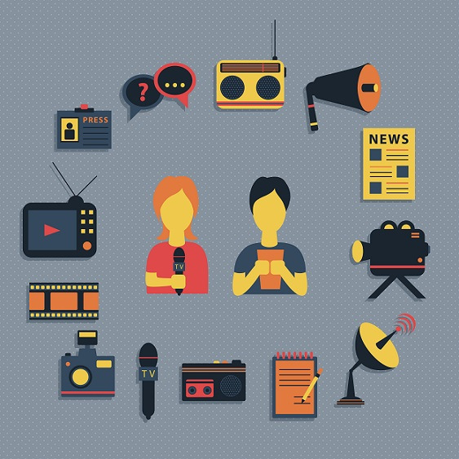
Mass Communication
Means of conveying messages to an entire populace.
Tools of modern mass media include books, the press, cinema, television, radio, internet etc.
https://www.olympiadgenius.com/
Notes:
https://www.google.com/url?sa=i&url=https%3A%2F%2Fwww.olympiadgenius.com%2Fstudy-material%2F%3F_id%3D961&psig=AOvVaw0tS0xYGAwmDlBIb5uTQchs&ust=1591777291463000&source=images&cd=vfe&ved=0CAIQjRxqFwoTCICK7tWm9OkCFQAAAAAdAAAAABAJ

Slide 9

Verbal Communication
Oral Communication – A face-to-face interaction between sender and receiver. For Example: Giving a presentation.
Written Communication – The sender uses the written mode to transmit his/her message. For Example: Writing reports and emails.
https://www.kindpng.com/
Notes:
https://www.google.com/url?sa=i&url=https%3A%2F%2Fwww.kindpng.com%2Fimgv%2FhJbJmJx_oral-written-communication-hd-png-download%2F&psig=AOvVaw2I4dEYL3m7xbV2gKzEolRX&ust=1591777762768000&source=images&cd=vfe&ved=0CAIQjRxqFwoTCPj5wr-o9OkCFQAAAAAdAAAAABAD

Slide 10
Preview Quiz (Non-verbal Communication)
1. A dishonest person avoids eye contact.
2. Crossing the hands, legs or the ankles is a defensive gesture.
3. Resting your head on the hand indicates interest in the subject.
4. Non-verbal communication is less intense and impactful than verbal communication.
5. Showing your thumbs up indicates a successfully completed job or interview.

Slide 11
Preview Quiz Answers
1. A dishonest person avoids eye contact. TRUE
2. Crossing the hands, legs or the ankles is a defensive gesture. TRUE
3. Resting your head on the hand indicates interest in the subject. FALSE
4. Non-verbal communication is less intense and impactful than verbal communication. FALSE
5. Showing your thumbs up indicates a successfully completed job or interview. TRUE

Slide 12
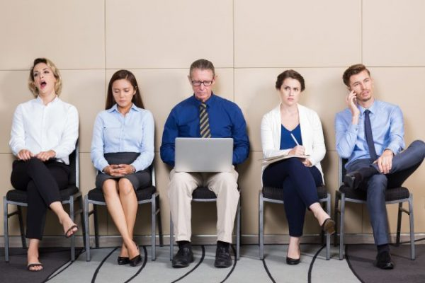
Non-verbal Communication
Message is communicated without using a word.
The process requires non-verbal cues to be transmitted and received.
Facial expressions, posture, eye contact, walk, person’s voice, sign language, body language volume, pitch, voice modulation etc.
https://hollisterinstitute.com/
Notes:
https://www.google.com/url?sa=i&url=https%3A%2F%2Fhollisterinstitute.com%2Fimproving-non-verbal-communication%2F&psig=AOvVaw0YNgnyOhXBdUHwpFijVWIm&ust=1591778258424000&source=images&cd=vfe&ved=0CAIQjRxqFwoTCKD2-aGq9OkCFQAAAAAdAAAAABAi

Slide 13
Non-verbal Communication
Kinesics (or body movements): Deliberate hand gestures and head movements.
Proxemics (or closeness/personal space): Measure of physical distance.
Posture: Way you sit or stand.
Eye contact: Way of gauging interest or disinterest.
Touch: Physical touch like a hug or a handshake.
Paralanguage: Vocal qualities like loudness or tone of voice.
Facial expressions: Indicators of someone’s attitude.
Physiology: Changes in body physiology like an increase in sweat or blinking rapidly.

Slide 14
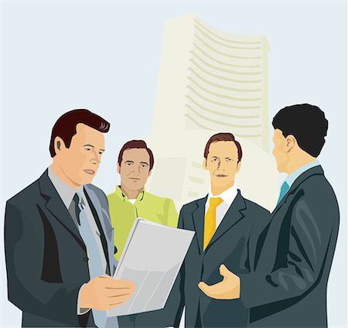
Formal Communication
Communication through formal channels in organizational structure along the lines of authority.
Such communications are in writing and may take any form; policy; manual: procedures and rule book; memoranda; official meetings; reports, etc.
https://www.masterfile.com/
Notes:
https://www.google.com/url?sa=i&url=https%3A%2F%2Fwww.masterfile.com%2Fsearch%2Fen%2Fformal%2Bcommunication%2Bcartoon&psig=AOvVaw3S63nTGdfDkQMtEnDGUZJr&ust=1591779132751000&source=images&cd=vfe&ved=0CAIQjRxqFwoTCNiYn8Ot9OkCFQAAAAAdAAAAABAn

Slide 15
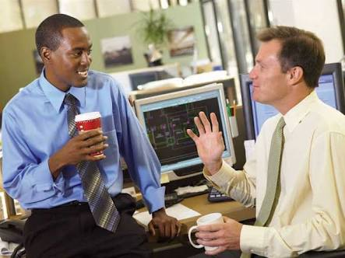
Informal Communication
Communication through channels other than formal channels.
Does not follow lines of authority.
Communication is usually oral and may be covered even by simple glance, gesture, smile or silence.
It includes Grapevine Communication.
https://freebcomnotes.blogspot.com/
Notes:
https://www.google.com/url?sa=i&url=https%3A%2F%2Ffreebcomnotes.blogspot.com%2F2016%2F11%2Fadvantages-disadvantages-of-formal_20.html&psig=AOvVaw1j4mmNq5HvSET-oKLroZ6Y&ust=1591779398671000&source=images&cd=vfe&ved=0CAIQjRxqFwoTCIiylM2u9OkCFQAAAAAdAAAAABAD

Slide 16
Formal | Informal
Official Channel | Unofficial Channel
Planned & Systematic | Cuts across formal relationships
Goal and task oriented | Individual Goal and need oriented
Impersonal | Personal & Social
Stable and rigid | Flexible and instable
Slow & Structured | Fast & unstructured
Authentic – little chance of distortion | Non- Authentic - bigger chance of distortion
.

Slide 17
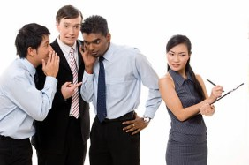
Informal Communication - Grapevine
Informal communication
Stretches throughout the organization in all directions.
Irrespective of the authority levels.
Not easy to trace the cause.
https://www.iedunote.com/
Notes:
https://www.google.com/url?sa=i&url=https%3A%2F%2Fwww.iedunote.com%2Fgrapevine&psig=AOvVaw2Ta07veaGe-LW9969YgDYm&ust=1591779661702000&source=images&cd=vfe&ved=0CAIQjRxqFwoTCLje3NWv9OkCFQAAAAAdAAAAABAN

Slide 18
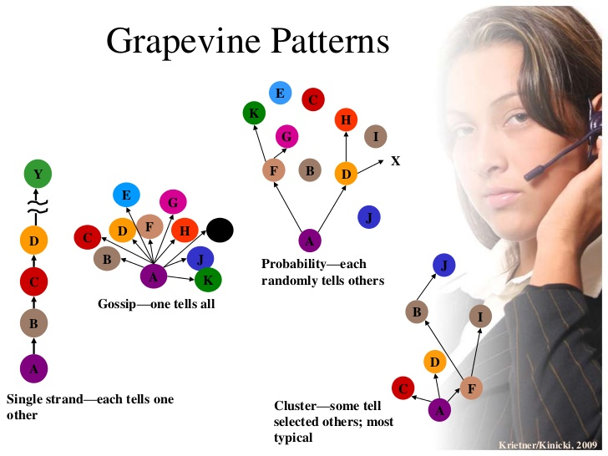
https://www.slideshare.net/
Notes:
https://www.google.com/url?sa=i&url=https%3A%2F%2Fwww.slideshare.net%2Fjonrwallace%2Fob-communication-and-networking&psig=AOvVaw0YVXIIgu0nGriI_ipa_0Vx&ust=1591779833605000&source=images&cd=vfe&ved=0CAIQjRxqFwoTCPDW0JSw9OkCFQAAAAAdAAAAABAI

Slide 19
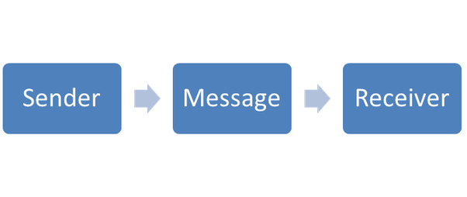
One-way Communication
Transfer of information in one direction from the sender to the receiver.
There is no opportunity for the receiver to give feedback to the sender. For Example: weather report on television, newspaper, billboard messages.
https://www.quora.com/
Notes:
https://www.google.com/url?sa=i&url=https%3A%2F%2Fwww.quora.com%2FWhat-is-one-way-communication&psig=AOvVaw33rv5ePqcj9Tq18ftVUP67&ust=1591780025469000&source=images&cd=vfe&ved=0CAIQjRxqFwoTCLiNpu2w9OkCFQAAAAAdAAAAABAb

Slide 20
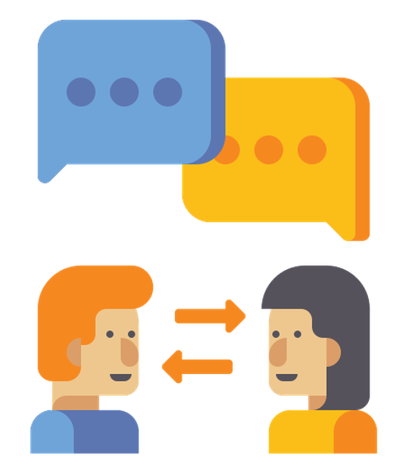
Two-way Communication
Transmission in which both parties are involved to transmit information.
For Example: Chat rooms and Instant Messaging, Telephone conversations etc.
https://www.flaticon.com/
Notes:
https://www.google.com/url?sa=i&url=https%3A%2F%2Fwww.flaticon.com%2Ffree-icon%2Ftwo-way-communication_2332750&psig=AOvVaw2DKgYDhpx6AfzJOvPSuIa9&ust=1591780289637000&source=images&cd=vfe&ved=0CAIQjRxqFwoTCPDLkO2x9OkCFQAAAAAdAAAAABAD

Slide 21
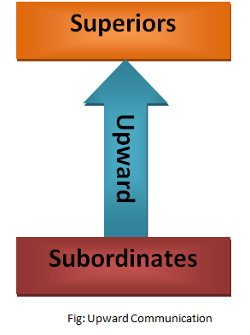
Upward Communication
The process of information flowing from the lower levels of a hierarchy to the upper levels.
Function: to send information, suggestions, complaints and grievances of the lower level workers to the managers above.
https://thebusinesscommunication.com/
Notes:
https://www.google.com/url?sa=i&url=https%3A%2F%2Fthebusinesscommunication.com%2Fwhat-is-upward-communication-media-or-ways-of-upward-communication%2F&psig=AOvVaw0fkUJqEtx29eX_zJOIYa5d&ust=1591780556423000&source=images&cd=vfe&ved=0CAIQjRxqFwoTCOipkKGz9OkCFQAAAAAdAAAAABAD

Slide 22
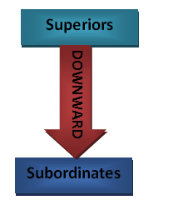
Downward Communication
Downward communication involves a message travelling to one or more receivers at the lower level in the hierarchy.
Involves directions or performance feedback.
The down ward flow of communication generally corresponds to the formal communication.
https://thebusinesscommunication.com/
Notes:
https://www.google.com/url?sa=i&url=https%3A%2F%2Fthebusinesscommunication.com%2Fwhat-is-vertical-communication-types-of-vertical-communication%2F&psig=AOvVaw2DbYaUVdrco1bT5R347QgN&ust=1591780962707000&source=images&cd=vfe&ved=0CAIQjRxqFwoTCNCzgLG09OkCFQAAAAAdAAAAABAS

Slide 23
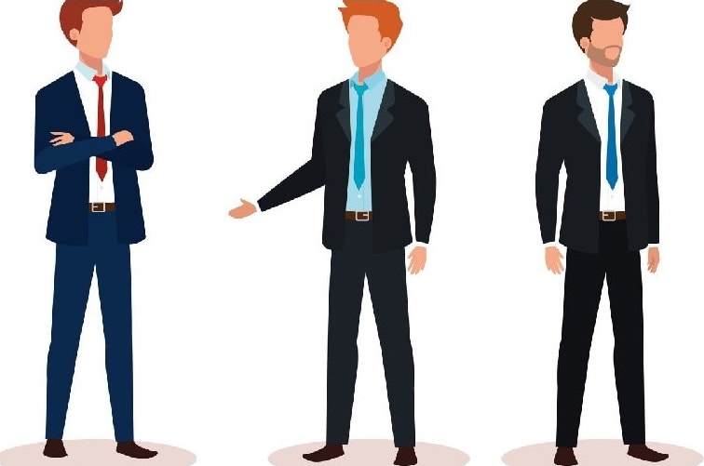
Lateral/Horizontal Communication
Takes place between persons at the same level or working.
The main use is to maintain coordination and review activities assigned to various subordinates.
https://www.marketing91.com/
Notes:
https://www.google.com/url?sa=i&url=https%3A%2F%2Fwww.marketing91.com%2Fhorizontal-communication%2F&psig=AOvVaw1qwJI6rixemE10ReE_OFvB&ust=1591781543778000&source=images&cd=vfe&ved=0CAIQjRxqFwoTCJCfqsK29OkCFQAAAAAdAAAAABAD

Slide 24
Models of Communication

Slide 25
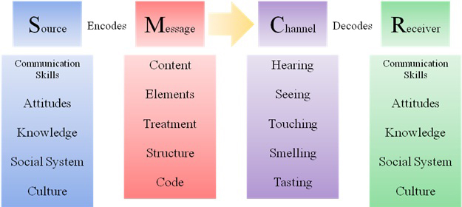
David Berlo’s SMCR Model
http://jayaseelansr.blogspot.com
Notes:
http://jayaseelansr.blogspot.com/2017/07/david-berlos-model-of-communication.html

Slide 26
Components of SMCR Model
Source is the sender of the message or the person who originates the message.
Message is the substance that is being sent by the sender to the receiver.
Channel is the medium used to send the message.
Receiver is the person who gets the message sent in the process.

Slide 27
Criticism of SMCR Model
There is no concept of feedback, so the effect is not considered.
There is no concept of noise or any kind of barriers in communication process.
It is a linear model of communication, there is no two way communication.
Both of the people must be similar according to all the factors, which is practically not possible.

Slide 28
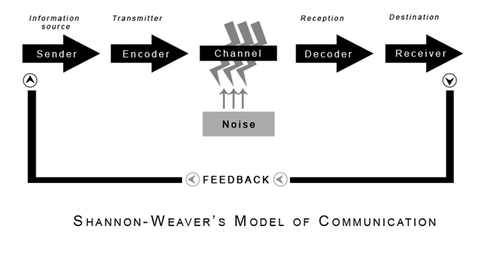
Shannon-Weaver Model
https://www.communicationtheory.org/
Notes:
https://www.google.com/url?sa=i&url=https%3A%2F%2Fwww.communicationtheory.org%2Fshannon-and-weaver-model-of-communication%2F&psig=AOvVaw0MoFDeXMmKAMFEGIU5u80t&ust=1591782013589000&source=images&cd=vfe&ved=0CAIQjRxqFwoTCMiSkJ-49OkCFQAAAAAdAAAAABAb

Slide 29
Components of Shannon-Weaver Model
Sender (Information source) – Sender is the person who makes the message, chooses the channel and sends the message.
Encoder (Transmitter) – Encoder is the sender who uses machine, which converts message into signals or binary data.
Channel – Channel is the medium used to send message.
Decoder (Receiver) – Receiver is the one who decodes the message.
Noise – Noise is the physical disturbances like environment, people, etc. which does not let the message get to the receiver as what is sent.

Slide 30
Criticism of Shannon-Weaver Model
It can be applied more for interpersonal communication than group communication and mass communication.
Receiver plays the passive part in the communication process as sender plays the primary role that sends messages.
Feedback is taken as less important in comparison to the messages sent by the sender.
The model is taken by some critics as a “misleading misrepresentation of the nature of human communication” as human communication is not mathematical in nature.

Slide 31
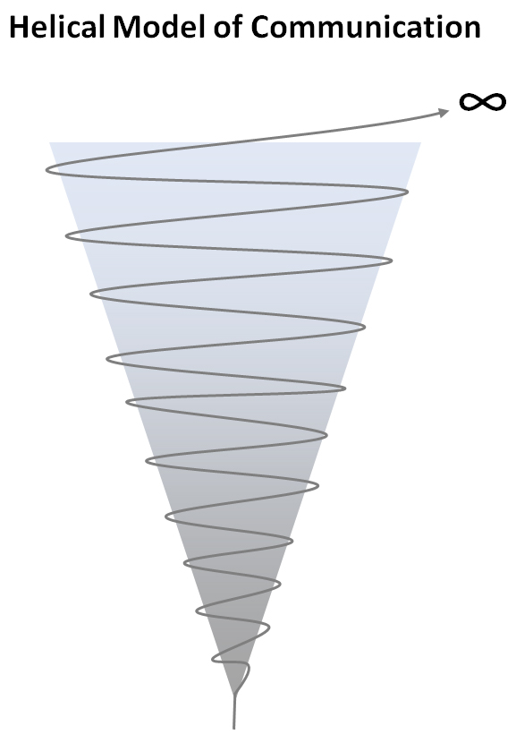
Helical Communication Model
“At any and all times, the helix gives geometrical testimony to the concept that communication while moving forward is at the same time coming back upon itself and being affected by its past behavior, for the coming curve of the helix is fundamentally affected by the curve from which it emerges.
The helical communication model offers a flexible communication process. ”
– Dance (1967

Slide 32
For Example
When a child is born, the only means of communication is crying. He/she cries for everything like hunger, pain, cold, etc. As the child grows, the means of communication of the child becomes wider and broader. He learns to make noises then he learns language to obtain attention and to fulfill his needs. It illustrates the development of an individual throughout life, as their knowledge base deepens and expands through communication; thus the helical model can be seen as dynamic.

Slide 33
Advantages and Disadvantages
Advantages
Disadvantages
The model takes into account the dimension of time in ways that most other models fail to do.
The model takes into account the ways learning throughout a cycle of communication leads to increasing complexity.
There is acknowledgement that every experience impacts upon our future actions, and that we cannot get a chance at re-doing an argument, discussion or moment that has passed.
The model is somewhat ambiguous due to its abstract nature.
The model assumes continuity and does not account for moments when there are breaks in communication

Slide 34
Applications
Applicable to both personal and professional life:
In personal life, good communication skills can improve your personal relationships by helping you to understand others, and to be understood.
Professionally, if you are applying for jobs or looking for a promotion, you will almost certainly need to demonstrate good communication skills.
Communication skills can also ensure that you are able to manage interactions with businesses and organisations.

Slide 35
Assessment Pattern
Students are assessed on the basis of the following parameters:
Hourly Test-2
Assignments
Surprise Test
Worksheets
Quiz
Student Engagement
End Semester Exam

Slide 36
References
Raman, M. and Sharma, S. (2017). Technical Communication - Principles and Practice, Oxford University Press: New Delhi
https://nptel.ac.in/courses/109/104/109104030/
www.managementstudyguide.com/business_communication.htm
www.skillsyouneed.com/ips/communication-skills.html
www.pressbooks.bccampus.ca/technicalwriting/chapter/casestudy-costpoorcommunication/
www.notesdesk.com/.../business-communications/business-communication-
https://www.ndsu.edu/fileadmin/staffsenate/Staff_Development/EFFECTIVE_COMMUNICATION_-_Staff_Senate.pptx

Slide 37
THANK YOU
For queries
Email: communicationskills.uilah@gmail.com

